Slide 1
Linear Discriminant Analysis
The basics of LDA
Applications
LDA vs PCA
The math

Slide 2
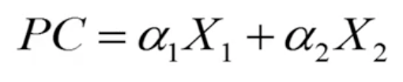
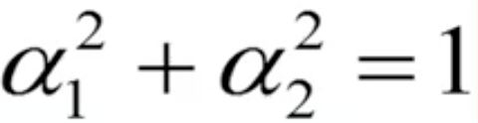

PCA vs LDA
PCA is a method to find the linear combination that accounts for as much variability as possible.
LDA is a similar method, which aims to maximize the separation between two or more groups.
Notes:
For example, let’s say we want to combine the two variables, X1 and X2. PCA will try to find the optimal values for the weights, alpha 1 and alpha 2 so that the combined variables has maximal variance. Remember that the values we use for the weights are constrained so that the sum of the squared weights is equal to 1.
Let’s say we want to combine the two variables, X1 and X2, LDA combines these two variables by using optimal values of the weights so that the combined variables shows maximal separation between the groups.

Slide 3
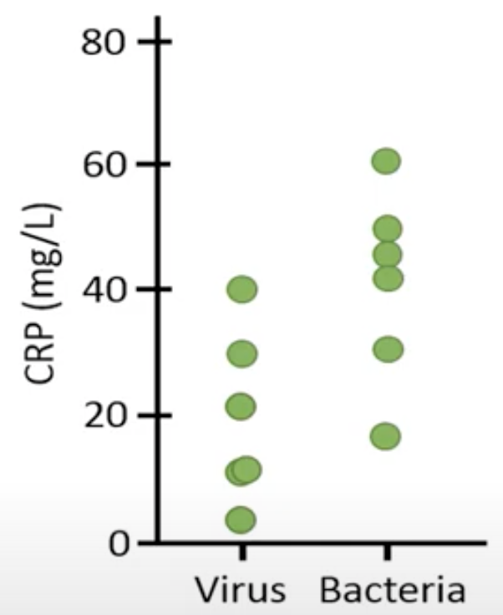
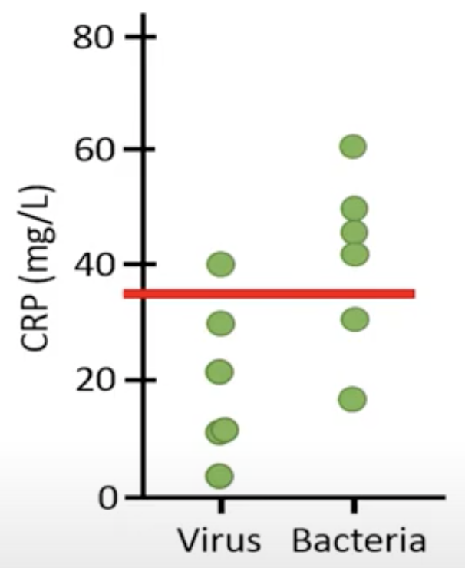
Separation
Infection | CRP(mg/L) | Temp (C)
Viral | 40 | 36
Viral | 11.1 | 37.2
Viral | 30 | 36.5
Viral | 21.4 | 39.4
Viral | 10.7 | 39.6
Viral | 3.4 | 40.7
Bacterial | 42 | 37.6
Bacterial | 31.1 | 42.2
Bacterial | 50 | 38.5
Bacterial | 60.4 | 39.4
Bacterial | 45.7 | 38.6
Bacterial | 17.3 | 42.7
Notes:
To explain separation, let’s have a look at the fictive dataset, which contains information of 12 patients. CRP shows the concentration of the c-reactive protein in blood from the time when the patients entered the hospital whereas this column shows the body temperature of the same patients at the same time point. Once the patients had entered the hospital, the presence of bacteria and viruses were analyzed from different samples. However, it usually takes several hours or days to determine if a patient has a viral infection or a bacterial infection. After 2 days at the hospital, these 6 patients were found to be infected by a virus whereas these 6 patients were confirmed to have a bacterial infection. Since antibiotics are only effective on bacteria , only these patients were treated with antibiotics. The problem is that we have to wait about 2 days to know if antibiotic treatment is appropriate or not. . It would be great if we could use the CRP concentration or the body temperature to tell if a patient has a bacterial or viral infection because the measurements of these variables can be done within just 1 hour.
If we plot the CRP concentration of the 12 patients, we can see that the ones with a viral infection generally have a lower concentration of CRP compared to the ones who have a bacterial infection.
Let’s say that we would use a cutoff value of 35, to determine if someone has a bacterial or viral infection. However, the problem with this cutoff line is that it cannot separate the groups very well . We can see that 4 patients with bacterial infection and one patient with viral infection are above the line whereas 5 patients with a viral infection and 2 patients with bacterial infection are below the line. Using this line, or any other horizontal line, it is impossible to separate the two groups completely.

Slide 4
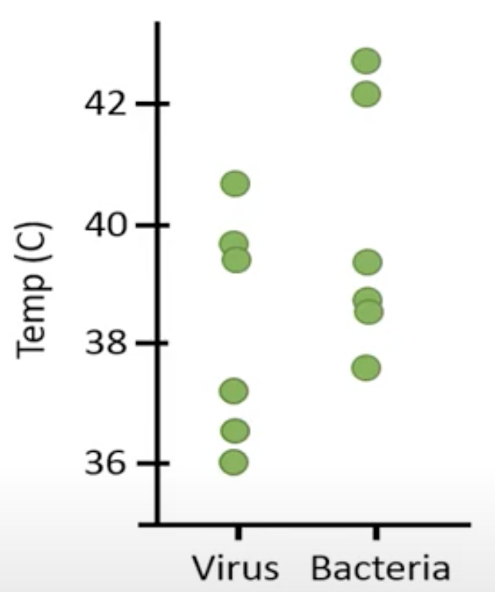
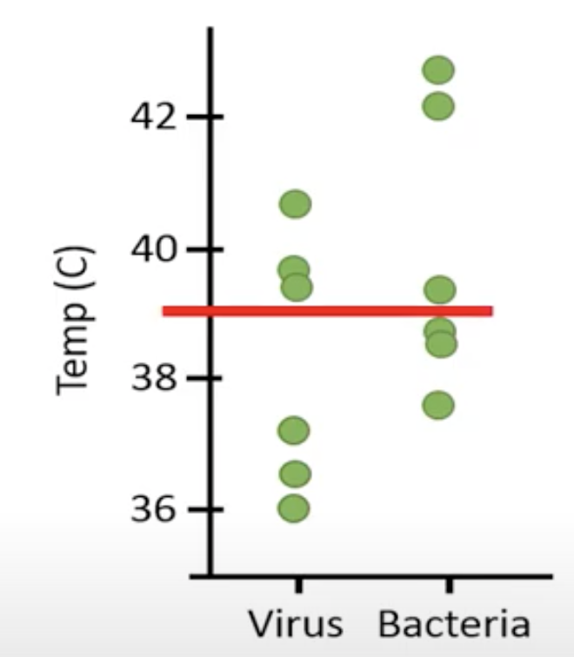
Separation
Infection | CRP(mg/L) | Temp (C)
Viral | 40 | 36
Viral | 11.1 | 37.2
Viral | 30 | 36.5
Viral | 21.4 | 39.4
Viral | 10.7 | 39.6
Viral | 3.4 | 40.7
Bacterial | 42 | 37.6
Bacterial | 31.1 | 42.2
Bacterial | 50 | 38.5
Bacterial | 60.4 | 39.4
Bacterial | 45.7 | 38.6
Bacterial | 17.3 | 42.7
Notes:
Let’s check if it is possible to use the body temperature to tell if a patient has a viral or bacterial infection?
We can see that we have the same problem again. There is no line can separate the two groups of patients.

Slide 5
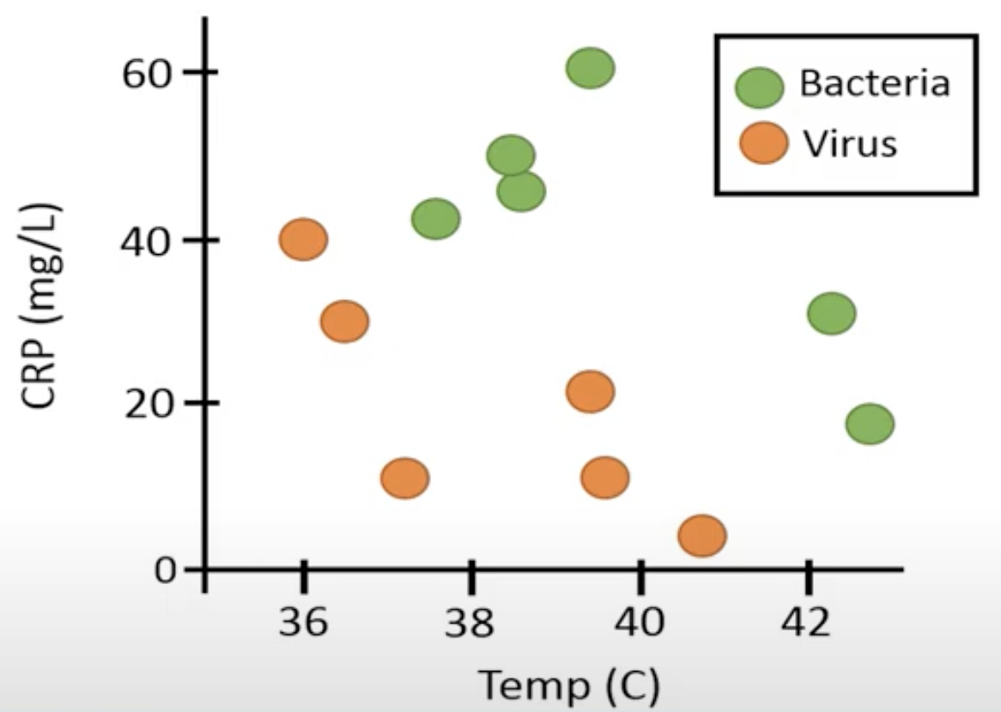
Separation
Infection | CRP(mg/L) | Temp (C)
Viral | 40 | 36
Viral | 11.1 | 37.2
Viral | 30 | 36.5
Viral | 21.4 | 39.4
Viral | 10.7 | 39.6
Viral | 3.4 | 40.7
Bacterial | 42 | 37.6
Bacterial | 31.1 | 42.2
Bacterial | 50 | 38.5
Bacterial | 60.4 | 39.4
Bacterial | 45.7 | 38.6
Bacterial | 17.3 | 42.7
Notes:
However, if we plot the CRP concentration and the body temperature in the same plot and use different colors for patients with a viral infection and bacterial infection. We can see that the line can separate the 2 groups completely. By combining the 2 variables, we can get a better separation between the two groups compared to if we use one of the variables alone .

Slide 6
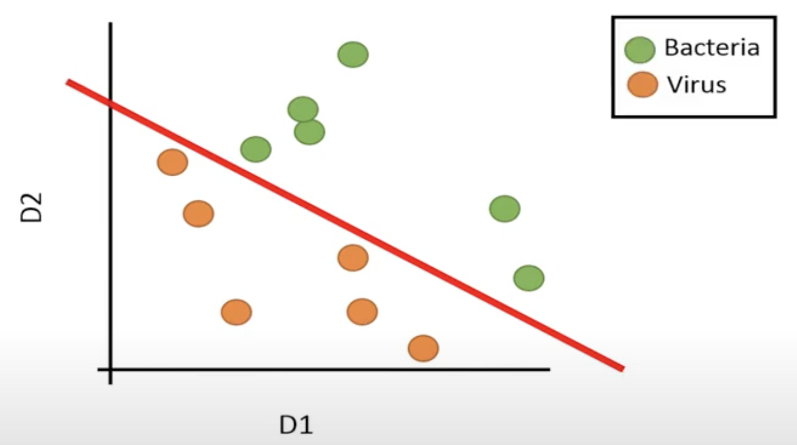
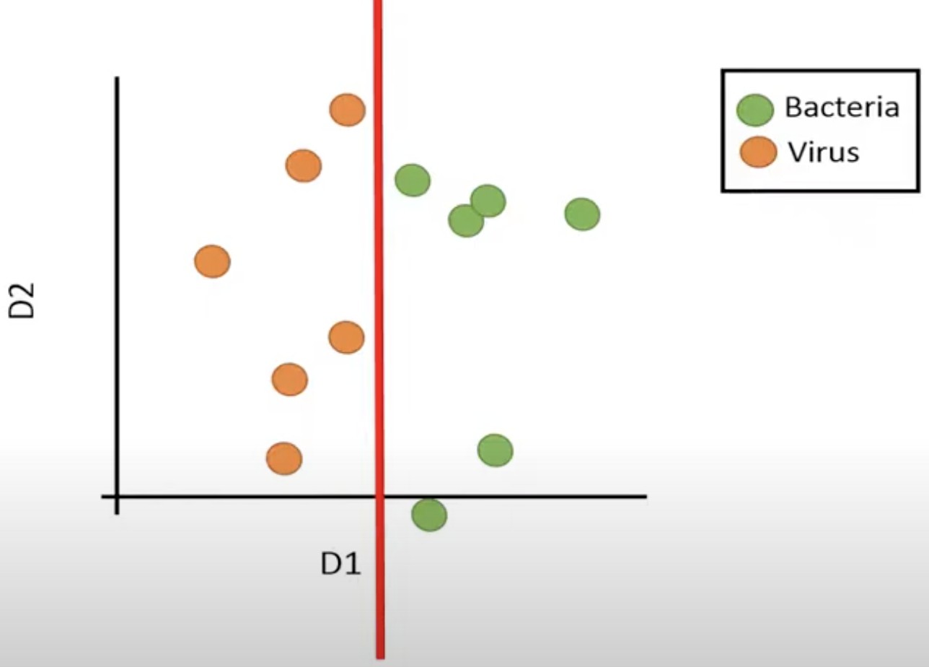
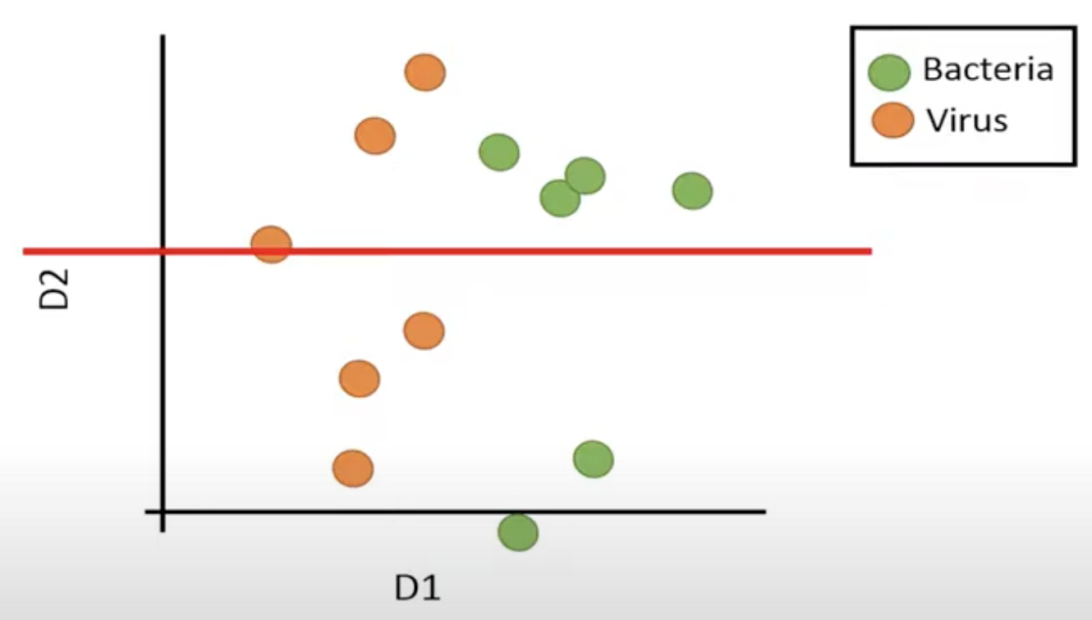
LDA
The first discriminant function can be used to separate the two groups perfectly.
The second discriminant function is not useful for separation.
Notes:
Just as PCA LDA can be seen as we rotate the data into two new dimensions like this. The new dimensions are called discriminant function one and two. We can see that the first discriminant function can be used to separate the two groups perfectly. In contrast, we can’t see separate the groups based on a horizontal line, which means that the second discriminant function is not useful for separation.

Slide 7

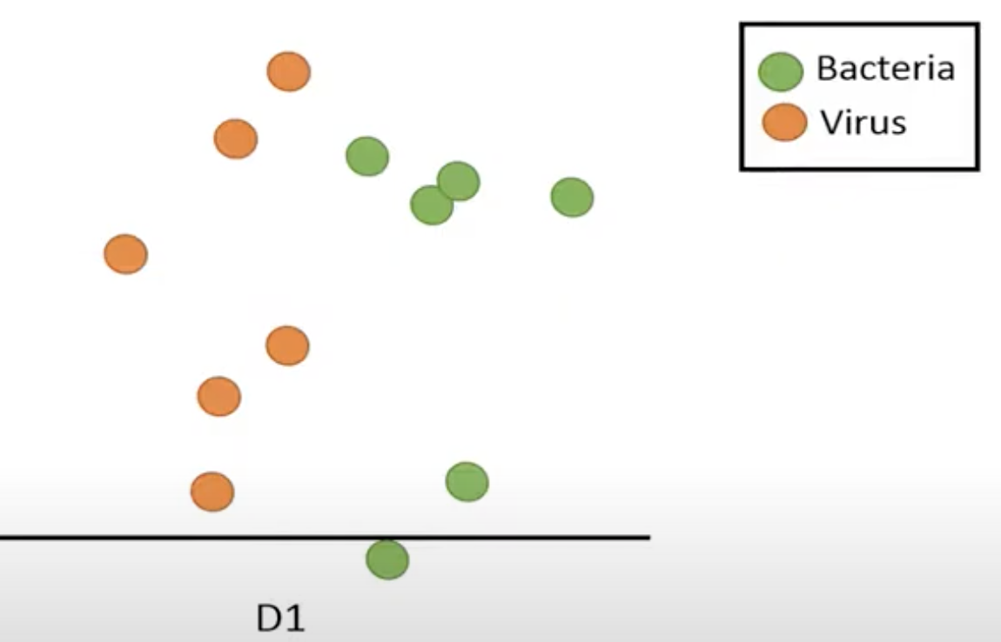
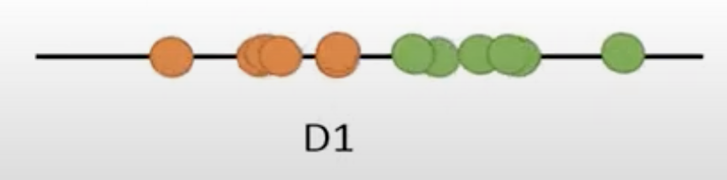
LDA
The data points are plotted vertically
Delete the second discriminant function
Place all data points on just one line
Notes:
Therefore, we can delete the second discriminant function and place all data points on just one line. We rotate the plot so that the data points are plotted vertically. If we use LDA, we can plot the so-called discriminant scores like this.

Slide 8
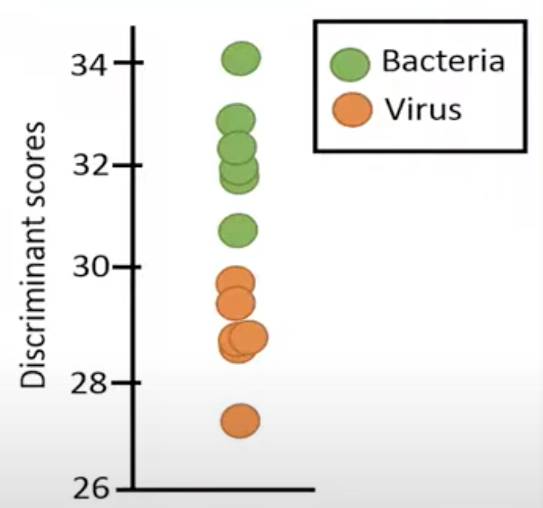
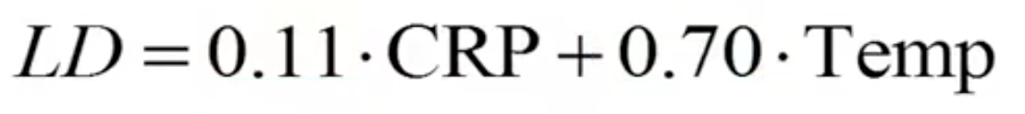
LDA
Notes:
We can place a line like this that gives us a perfect separation between 2 groups. By using LDA we have combined the two variables, CRP and body temperature in a way that has maximized the separation between the two groups.
The linear discriminant scores in this plot can be obtained by this equation. We can replace X1 and X2 with the variable names CRP and Temp.
The values of the weights , alpha 1 and alpha 2, were computed with a statistical software to 0.11 and 0.7. These values give us the optimal separation between the groups.

Slide 9
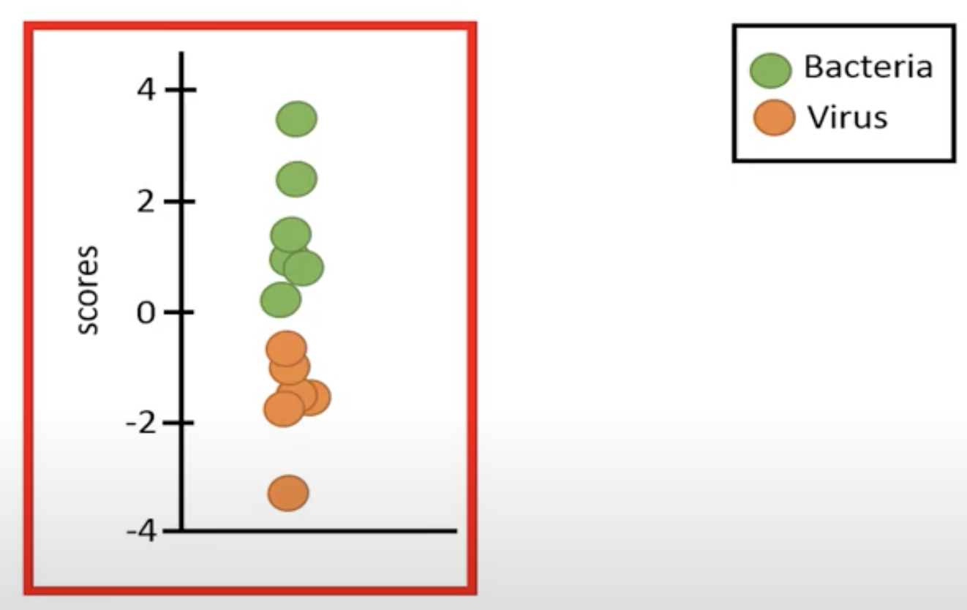
LDA
Infection | CRP(mg/L) | Temp (C) | Scores | Center scores
Viral | 40 | 36 | 29.5 | -1.1
Viral | 11.1 | 37.2 | 27.3 | -3.3
Viral | 30 | 36.5 | 28.8 | -1.8
Viral | 21.4 | 39.4 | 29.9 | -0.7
Viral | 10.7 | 39.6 | 28.9 | -1.7
Viral | 3.4 | 40.7 | 28.9 | -1.7
Bacterial | 42 | 37.6 | 30.8 | 0.2
Bacterial | 31.1 | 42.2 | 32.9 | 2.3
Bacterial | 50 | 38.5 | 32.3 | 1.7
Bacterial | 60.4 | 39.4 | 34 | 3.5
Bacterial | 45.7 | 38.6 | 31.9 | 1.3
Bacterial | 17.3 | 42.7 | 31.8 | 1.2
Notes:
Let’s use this equation to calculate the discriminant scores. We can see that the scores for the ones with a viral infection are lower compared to the ones who have a bacterial infection.
Most software tools report the centered discriminant scores, which means that we should subtract the corresponding means from the original values before we calculate the scores.
By using this equation, the following centered scores were calculated. If we plot the centered scores, we can see that the scores center around zero since the mean of these scores is equal to 0.

Slide 10
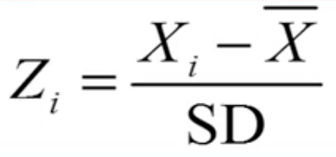
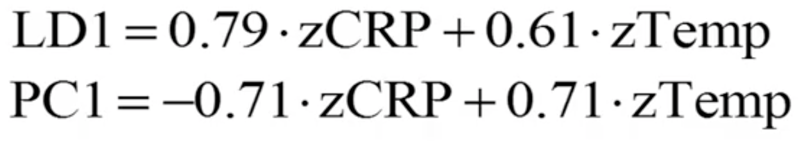
LDA vs PCA
Infection | CRP(mg/L) | Temp (C)
Viral | 0.5 | -1.4
Viral | -1.1 | -0.9
Viral | 0 | -1.2
Viral | -0.5 | 0.2
Viral | -1.1 | 0.3
Viral | -1.5 | 0.8
Bacterial | 0.7 | -0.7
Bacterial | 0 | 1.5
Bacterial | 1.1 | -0.3
Bacterial | 1.7 | 0.2
Bacterial | 0.9 | -0.2
Bacterial | -0.7 | 1.7
var | 1 | 1
Formula for standardize variable
The weights from LDA and PCA
Notes:
To make a fair comparison between the two methods, we will first standardize the two variables so that they both have a mean of zero and standard deviation of one. Remember that we can standardize a variable by this formula, where we subtract the mean from the values of that variable and divide by its standard deviation.
By using the standardized data, we have the weights from LDA and PCA. Note that the variables represent standardized variables with a mean of 0 and a standard deviation of 1

Slide 11
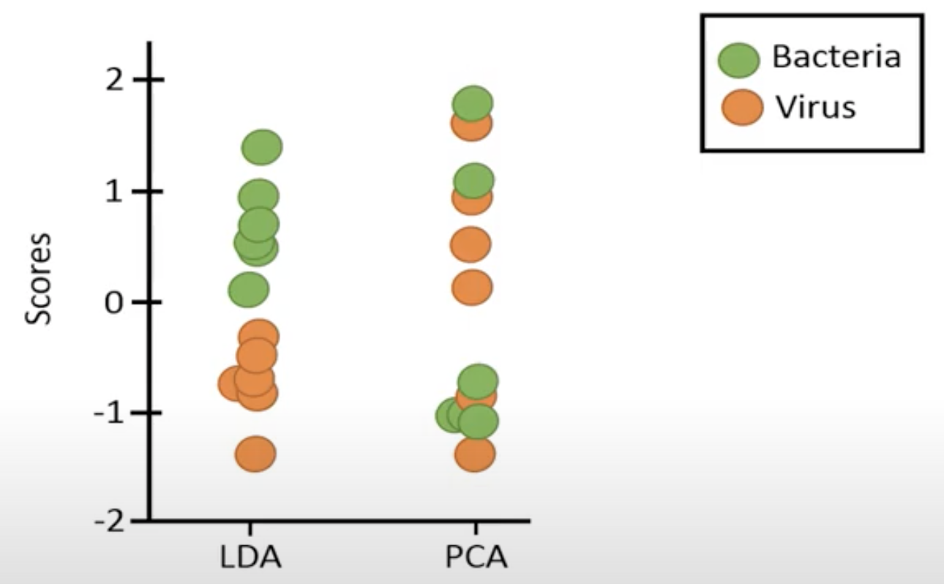
LDA vs PCA
Using these equations to compute the scores
Infection | CRP(mg/L) | Temp (C) | Scores LDA | Scores PCA
Viral | 0.5 | -1.4 | -0.5 | -1.4
Viral | -1.1 | -0.9 | -1.4 | 0.1
Viral | 0 | -1.2 | -0.8 | -0.8
Viral | -0.5 | 0.2 | -0.3 | 0.5
Viral | -1.1 | 0.3 | -0.7 | 1
Viral | -1.5 | 0.8 | -0.7 | 1.6
Bacterial | 0.7 | -0.7 | 0.1 | -0.9
Bacterial | 0 | 1.5 | 1 | 1
Bacterial | 1.1 | -0.3 | 0.7 | -1
Bacterial | 1.7 | 0.2 | 1.4 | -1.1
Bacterial | 0.9 | -0.2 | 0.6 | -0.8
Bacterial | -0.7 | 1.7 | 0.5 | 1.8
var | 1 | 1 | 0.71 | 1.29
Notes:
By using these equations, we can compute scores based on PCA and LDA. The variance of the scores for the first principal component is 1.29 but only 0.71 for the scores based on the first discriminant function. This is no surprise since PCA aims to maximize the variance of the first principal component, whereas LDA aims to maximize the separation of the two groups.
If we plot scores computed by LDA, we see that the scores for the bacterial group are completely separated from the scores of the virus group. In comparison, the scores computed by PCA shows no clear separation between the group. Although PCA has captured more variation in the combined variable, it does not separate the groups as well. Note that, when we run PCA, we won’t use this grouping variable at all, whereas in LDA, we must provide this grouping variable since the method aims to find the maximal separation between these two groups. Since PCA will only be based on these 2 variables, without any information about the groups, it will not be as effective as LDA in separating the groups. PCA is sometimes referred to as an unsupervised method because it has no information if a data point belongs to a certain group, whereas LDA is referred to as a supervised method because it has information about which group a data point belongs to in order to fins the best separation between the groups

Slide 12
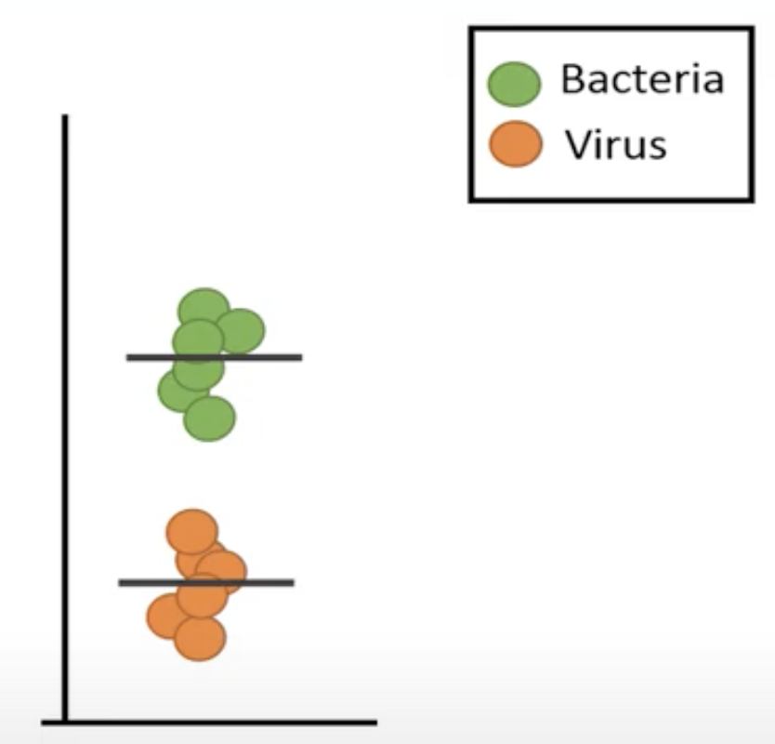
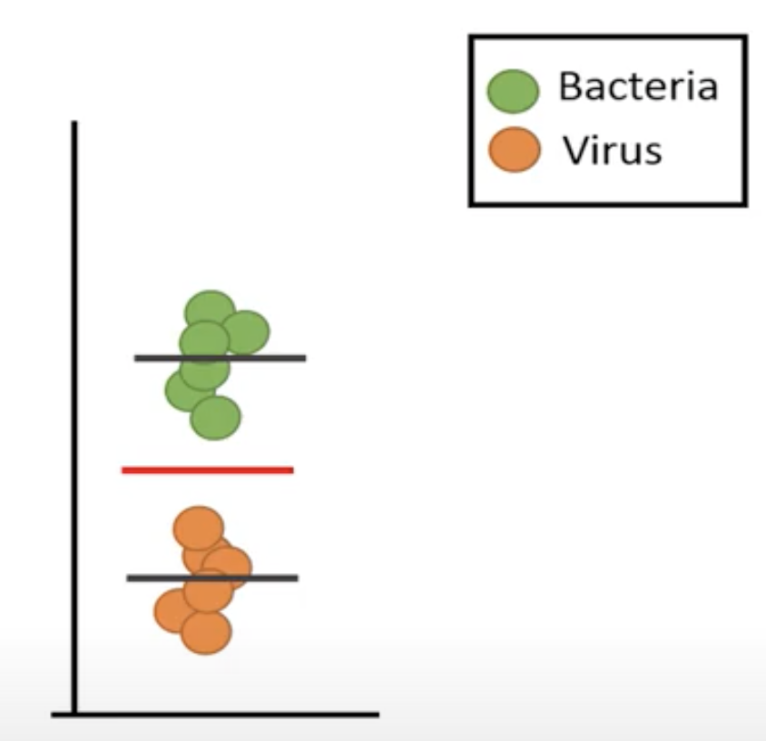
The weights
Separation between the groups
The grand mean
The means of the groups are far away from each other
Notes:
Now we focus on how to calculate the weights for the LDA. Remember that the weights for the PCA were extracted from the first eigenvector of the covariance matrix. These weights can be rescaled to loadings. The weights in LDA are also extracted from the first eigenvector, but an eigenvector of a different matrix. These weights are also usually rescaled.
Let’s first have a look at what determines how well 2 groups are separated. For this data, we can see that the two groups separate very well. This is due to the means of the groups are far away from each other. If the means are closer to each other, we can no longer see a clear separation between the two groups. The second reason why these 2 groups show a good separation is because the spread within the groups is small. The data points are close to the mean values. However, if there is a much larger spread of the observations around the means, then there is no longer a clear separation between the groups even though the difference in their means stay the same.
If we calculate a grand mean, which is a mean based on all data points, we can think of these distances as how much the group means varies from the gran mean. Of the means are close, the variation of the group means around the grand mean is small, and if the two means are far away from each other, there will be a large variation of the group means around the grand mean.

Slide 13
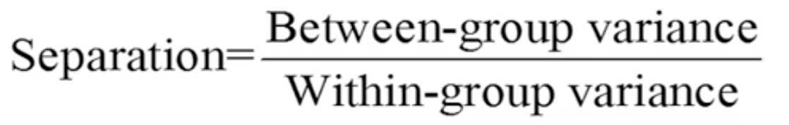
Separation between the groups
The separation between the groups depends on the variance between the groups.
The ratio of these measures should be as large as possible to get a clear separation between the groups.
Notes:
We can conclude that the separation between the groups depends on the variance between the groups, which is called between-group variance, and the variance within the groups, the within–group variance. Note that this ratio is similar to the ratio used for ANOVA. To get a good separation between the groups, the two-group means are far away each other, which means that the between-group variance should be large and that the variation within the group should be small, which will result in a low value of the within-group variance. Thus, the ratio of these measures should be as large as possible to get a clear separation between the groups.
LDA combines variables based on this ratio, where the aim is to transform the data so that the between-group variance is increased and the within-group variance is reduced.

Slide 14
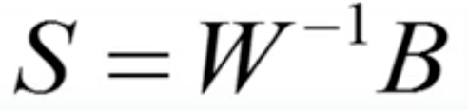
Separation between the groups
S is the target matrix
B is the between-group covariance matrix.
W is the pooled within-group covariance matrix.
Notes:
In matrix form, the separation can be described like this where B is the between-group covariance matrix and W is the pooled within-group covariance matrix. Matrix S is the target matrix. We will compute the eigenvectors of this matrix in order to get the weights.

Slide 15
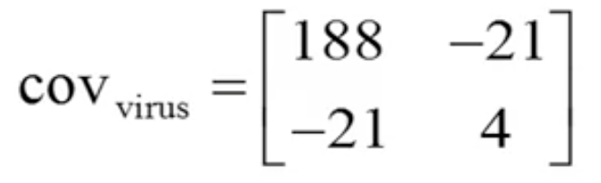
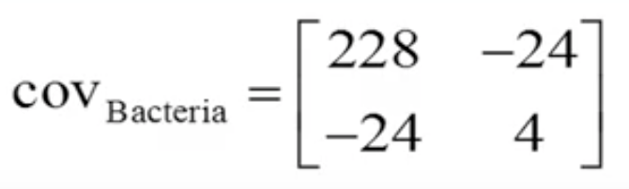
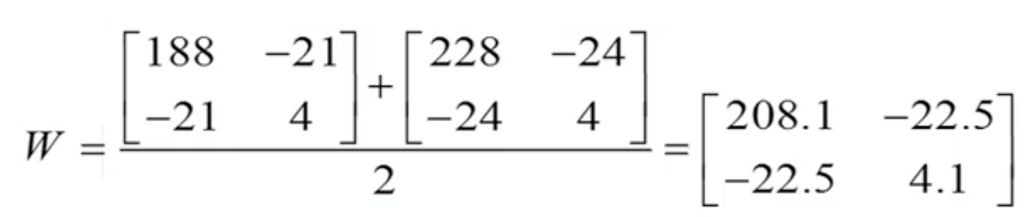
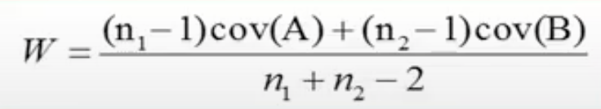
The math behind LDA
Infection | CRP(mg/L) | Temp (C)
Viral | 40 | 36
Viral | 11.1 | 37.2
Viral | 30 | 36.5
Viral | 21.4 | 39.4
Viral | 10.7 | 39.6
Viral | 3.4 | 40.7
Bacterial | 42 | 37.6
Bacterial | 31.1 | 42.2
Bacterial | 50 | 38.5
Bacterial | 60.4 | 39.4
Bacterial | 45.7 | 38.6
Bacterial | 17.3 | 42.7
The covariance matrix for the virus group
The covariance matrix for the bacteria group
This equation is used for an unequal sample size
Notes:
To calculate matrix S, we need to calculate the pooled within-group covariance matrix and the between-group covariance matrix. To calculate the pooled within-group covariance matrix, we calculate the covariance matrix for the virus group and bacteria group. Note that the values in these two matrices have been rounded. Since the sample sizes are equal to two groups, the pooled within-group covariance matrix is simply the mean of these two covariance matrices.

Slide 16
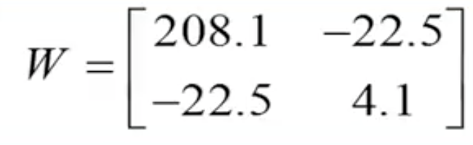
Pooled within-group covariance matrix
Infection | CRP(mg/L) | Temp (C)
Viral | 40 | 36
Viral | 11.1 | 37.2
Viral | 30 | 36.5
Viral | 21.4 | 39.4
Viral | 10.7 | 39.6
Viral | 3.4 | 40.7
Bacterial | 42 | 37.6
Bacterial | 31.1 | 42.2
Bacterial | 50 | 38.5
Bacterial | 60.4 | 39.4
Bacterial | 45.7 | 38.6
Bacterial | 17.3 | 42.7
Notes:
We have the pooled within-group covariance matrix here

Slide 17

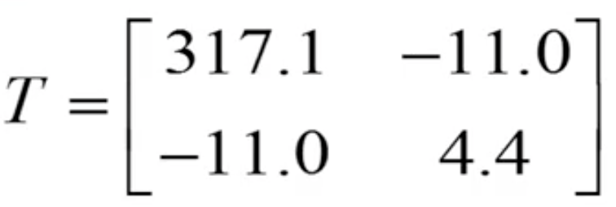
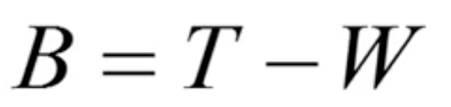
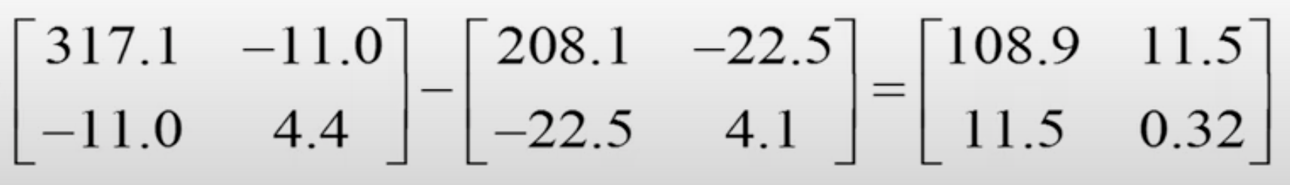
Between-group covariance matrix
The total covariance
The total covariance matrix is the covariance matrix based on all data points
The between-group covariance matrix
Infection | CRP(mg/L) | Temp (C)
Viral | 40 | 36
Viral | 11.1 | 37.2
Viral | 30 | 36.5
Viral | 21.4 | 39.4
Viral | 10.7 | 39.6
Viral | 3.4 | 40.7
Bacterial | 42 | 37.6
Bacterial | 31.1 | 42.2
Bacterial | 50 | 38.5
Bacterial | 60.4 | 39.4
Bacterial | 45.7 | 38.6
Bacterial | 17.3 | 42.7
=
Notes:
A simple way to calculate the between-group covariance matrix is to first calculate the total covariance because the between-group covariance is equal to the total variance minus the pooled within-group covariance. This is the total covariance matrix, which shows the variance and covariance of the two variables when we don’t separate the groups.
The total covariance matrix is the covariance matrix based on all data points. This matrix is the same covariance matrix that we would use for computing the PCA.

Slide 18
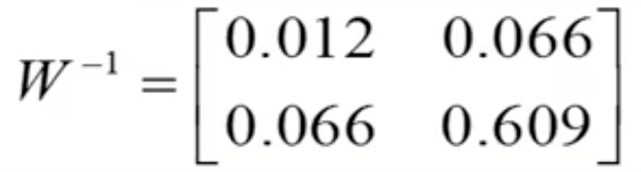
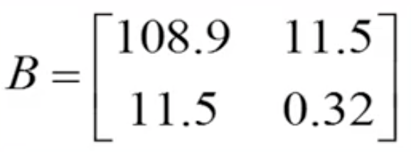
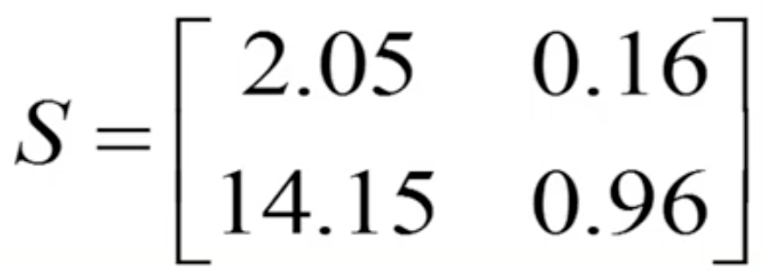
The math behind LDA
The inverse of the pooled within-group covariance matrix
Notes:
We calculate the inverse of the pooled within-group covariance matrix.

Slide 19
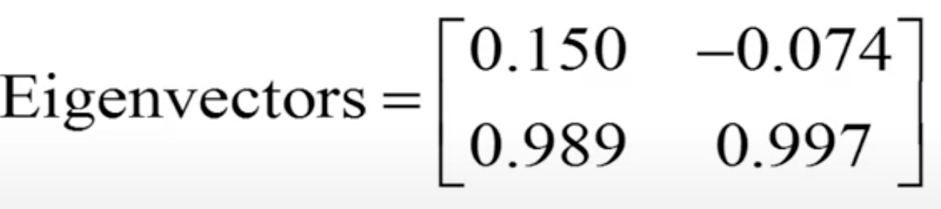
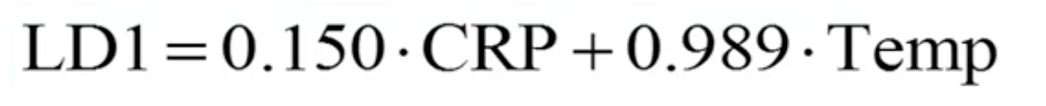
The math behind LDA
Notes:
Once we have calculated matrix S, the rest of the calculations are similar to those used in PCA. However, instead of calculating the eigenvalues and eigenvectors of the covariance matrix, we will calculate these on the following matrix. Then we combine the two variables, the CRP and the body temperature , by using the weights that are provided by the first eigenvector. By using this equation, with the given weights, we can calculate the discriminant scores that will show the best linear separation between the groups.

Slide 20



Calculate the score
Infection | CRP(mg/L) | Temp (C) | Scores
Viral | 40 | 36 | 41.6
Viral | 11.1 | 37.2 | 38.4
Viral | 30 | 36.5 | 40.6
Viral | 21.4 | 39.4 | 42.2
Viral | 10.7 | 39.6 | 40.8
Viral | 3.4 | 40.7 | 40.8
Bacterial | 42 | 37.6 | 43.5
Bacterial | 31.1 | 42.2 | 46.4
Bacterial | 50 | 38.5 | 45.5
Bacterial | 60.4 | 39.4 | 48
Bacterial | 45.7 | 38.6 | 45
Bacterial | 17.3 | 42.7 | 44.8
The variance of the scores for the virus group
The variance of the scores for the bacteria group
The average of these variances
Notes:
These are the calculated unstandardized scores. We now rescale these weights so that they correspond to the weights and loadings that are commonly shown by most statistical software tool. In LDA, the weights are usually rescaled so that the pooled group variance of the scores is equal to 1. Let’s calculate the variance of the scores for the virus group. The variance of these scores are 1.6 and the variance of the scores for the bacteria group is 2.37. The average of these variances is 1.989, which is the pooled variance since the two groups have an equal sample size. If the two groups have an unequal sample size, we need to calculate a weighted mean instead.

Slide 21
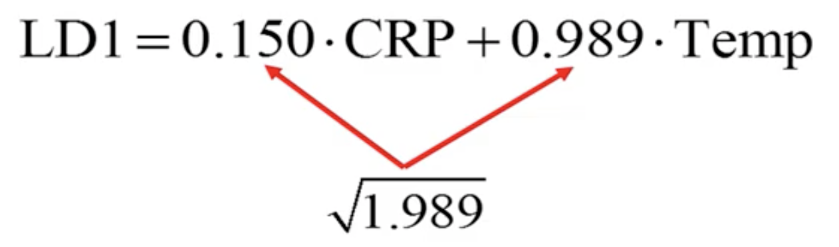

Normalize the weights
Infection | CRP(mg/L) | Temp (C) | Scores | New Scores
Viral | 40 | 36 | 41.6 | 29.5
Viral | 11.1 | 37.2 | 38.4 | 27.3
Viral | 30 | 36.5 | 40.6 | 28.8
Viral | 21.4 | 39.4 | 42.2 | 29.9
Viral | 10.7 | 39.6 | 40.8 | 28.9
Viral | 3.4 | 40.7 | 40.8 | 28.9
Bacterial | 42 | 37.6 | 43.5 | 30.8
Bacterial | 31.1 | 42.2 | 46.4 | 32.9
Bacterial | 50 | 38.5 | 45.5 | 32.3
Bacterial | 60.4 | 39.4 | 48 | 34
Bacterial | 45.7 | 38.6 | 45 | 31.9
Bacterial | 17.3 | 42.7 | 44.8 | 31.8
Notes:
If we divide the weights by the square root of the pooled variance, which corresponds to the pooled standard deviation, we get the following types of weights, or loadings, that are usually presented by most statistical software tools. By using this discriminant function with these rescaled weights, we can compute the following scores

Slide 22



Normalize the weights
Infection | CRP(mg/L) | Temp (C) | Scores | New Scores
Viral | 40 | 36 | 41.6 | 29.5
Viral | 11.1 | 37.2 | 38.4 | 27.3
Viral | 30 | 36.5 | 40.6 | 28.8
Viral | 21.4 | 39.4 | 42.2 | 29.9
Viral | 10.7 | 39.6 | 40.8 | 28.9
Viral | 3.4 | 40.7 | 40.8 | 28.9
Bacterial | 42 | 37.6 | 43.5 | 30.8
Bacterial | 31.1 | 42.2 | 46.4 | 32.9
Bacterial | 50 | 38.5 | 45.5 | 32.3
Bacterial | 60.4 | 39.4 | 48 | 34
Bacterial | 45.7 | 38.6 | 45 | 31.9
Bacterial | 17.3 | 42.7 | 44.8 | 31.8
The variance of the new scores for the virus group
The variance of the new scores for the bacteria group
The pooled variances
Notes:
If we divide the weights by the square root of the pooled variance, which corresponds to the pooled standard deviation, we get the following types of weights, or loadings, that are usually presented by most statistical software tools. By using this discriminant function with these rescaled weights, we can compute the following scores.

Slide 23
Centered scores
Infection | CRP (mg/L) | Temp (C) | Scores | New Scores | Center scores
Viral | 40 | 36 | 41.6 | 29.5 | -1.1
Viral | 11.1 | 37.2 | 38.4 | 27.3 | -3.3
Viral | 30 | 36.5 | 40.6 | 28.8 | -1.8
Viral | 21.4 | 39.4 | 42.2 | 29.9 | -0.7
Viral | 10.7 | 39.6 | 40.8 | 28.9 | -1.7
Viral | 3.4 | 40.7 | 40.8 | 28.9 | -1.7
Bacterial | 42 | 37.6 | 43.5 | 30.8 | 0.2
Bacterial | 31.1 | 42.2 | 46.4 | 32.9 | 2.3
Bacterial | 50 | 38.5 | 45.5 | 32.3 | 1.7
Bacterial | 60.4 | 39.4 | 48 | 34 | 3.5
Bacterial | 45.7 | 38.6 | 45 | 31.9 | 1.3
Bacterial | 17.3 | 42.7 | 44.8 | 31.8 | 1.2
Using this equation to have the center scores
Notes:
Note that, most of statistical tools will report the centered discriminant scores, which can be calculated based on the following equation, where we first subtract the means from the original values.

Slide 24
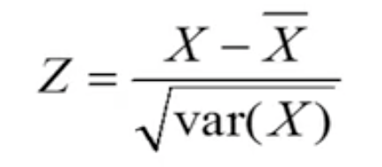


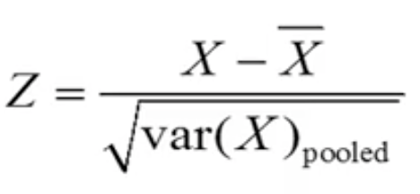

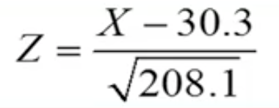

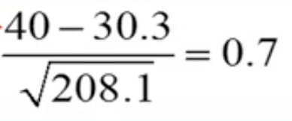
Standardized discriminant function coefficients
Infection | CRP(mg/L) | Temp (C) | Z CRP | Z Temp
Viral | 40 | 36 | 0.7 | -1.5
Viral | 11.1 | 37.2 | -1.3 | -0.9
Viral | 30 | 36.5 | 0 | -1.3
Viral | 21.4 | 39.4 | -0.6 | 0.2
Viral | 10.7 | 39.6 | -1.4 | 0.3
Viral | 3.4 | 40.7 | -1.9 | 0.8
Bacterial | 42 | 37.6 | 0.8 | -0.7
Bacterial | 31.1 | 42.2 | 0.1 | 1.6
Bacterial | 50 | 38.5 | 1.4 | -0.3
Bacterial | 60.4 | 39.4 | 2.1 | 0.2
Bacterial | 45.7 | 38.6 | 1.1 | -0.2
Bacterial | 17.3 | 42.7 | -0.9 | 1.8
Example: Calculate the standardized CRP value for person 1 z =
Notes:
One way to calculate these coefficients is to first compute the LDA on standardized data. To standardize a variable, we usually subtract its mean from the original values, and divide by the square root of the variance, which is the standard deviation of that variable. In contrast, for LDA we divide by the square root of the pooled variance of the groups for that variable. If we use this equation, we will get the following standardized variables.
We can now pool these two variables, and since the sample sizes are equal between the groups, the pooled variance is simply the mean of these two variance. We see that the pooled variance is 208.1. For example, if we calculate the standardized CRP value for person 1 and we see that the calculation results in a standardized value of 0.7

Slide 25

Standardized discriminant function coefficients
Infection | CRP(mg/L) | Temp (C) | Z CRP | Z Temp
Viral | 40 | 36 | 0.7 | -1.5
Viral | 11.1 | 37.2 | -1.3 | -0.9
Viral | 30 | 36.5 | 0 | -1.3
Viral | 21.4 | 39.4 | -0.6 | 0.2
Viral | 10.7 | 39.6 | -1.4 | 0.3
Viral | 3.4 | 40.7 | -1.9 | 0.8
Bacterial | 42 | 37.6 | 0.8 | -0.7
Bacterial | 31.1 | 42.2 | 0.1 | 1.6
Bacterial | 50 | 38.5 | 1.4 | -0.3
Bacterial | 60.4 | 39.4 | 2.1 | 0.2
Bacterial | 45.7 | 38.6 | 1.1 | -0.2
Bacterial | 17.3 | 42.7 | -0.9 | 1.8
After rescale
Notes:
Now we simply use these values to compute the scores of the first discriminant function. By using a software with these standardized values, we will get the following weights and if we rescale the weights in the same way as we have seen previously, we will get the following standardized discriminant function coefficients, which are commonly reported by most statistical software tools. These coefficients are usually used to determine how much each variable contributes to the separation. If a variable is associated with a relatively high weight, we can interpret this as the variable contributes more to the separation. In order words, if a variable is associated with a relative high weight, that variable is better to separate the groups compared to the other variables.
In our example, the values of the two coefficients are quite similar, which means that the variables CRP and body temperature contribute to about the same extent to separate the virus group from the bacteria group.

Slide 26
Thank you

